Slide 1
Machine Learning-Driven Rock Classification to Optimize Completion and Hydraulic Fracturing Performance in Tuscaloosa Marine Shale
Jamal Ahmadov, Cristina Mariana Ruse
Department of Petroleum Engineering, University of Louisiana at Lafayette

Slide 2
Outline
Introduction
Materials and Methods
Results
Conclusions
Acknowledgements
References

Slide 3
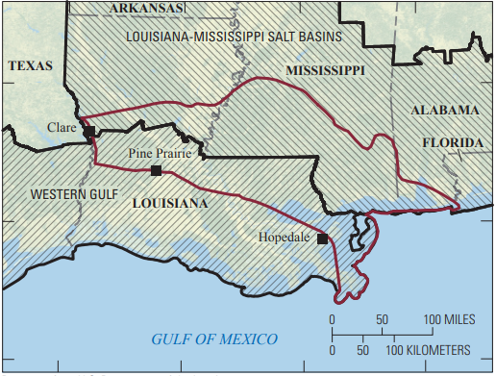
Introduction
Tuscaloosa Marine Shale
Unconventional reservoir across Central Louisiana and Southern Mississippi
Recoverable resources of 1.5 billion barrels of oil and 4.6 trillion cubic feet of gas
Figure 1. Tuscaloosa Marine Shale map (Hackley et. al, 2018)
Low acreage costs
Easy access to pipelines and refineries
High costs associated with drilling and completion
Figure 2. TMS costs and risks (https://www.netl.doe.gov)

Slide 4
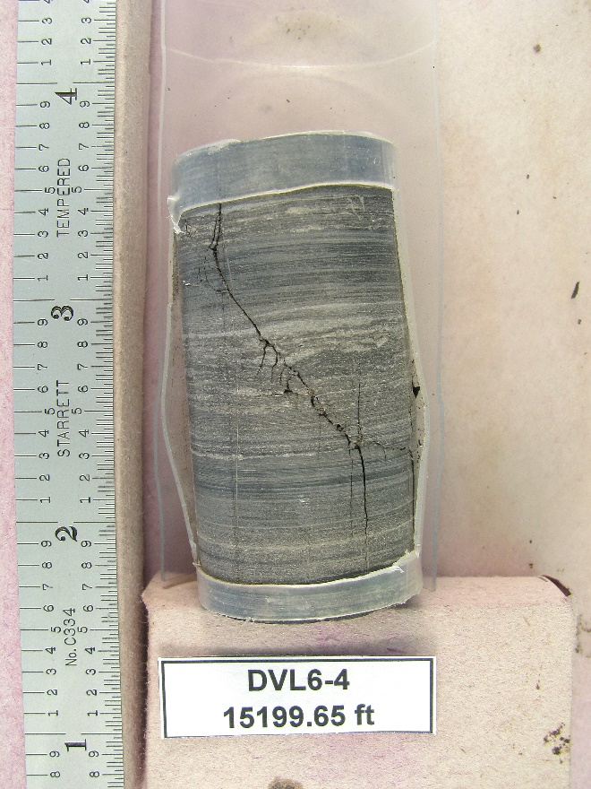
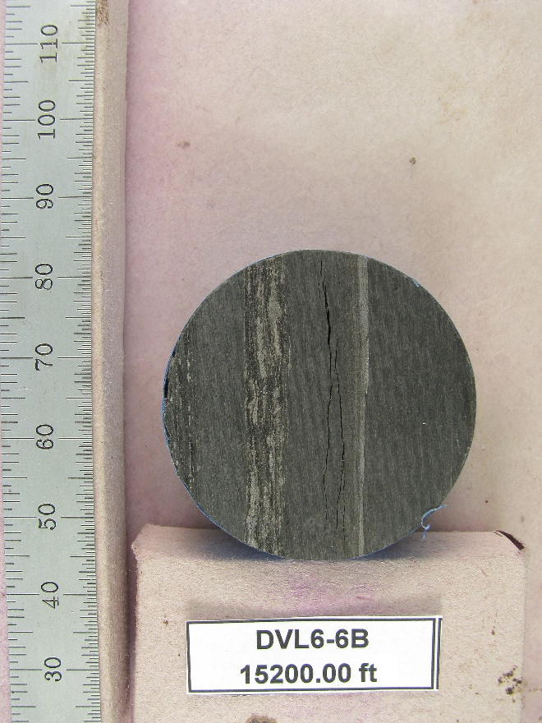
Introduction
Rapid changes in mineralogy
Thin layers of clay
1 inch
Figure 3. TMS rock samples, Courtesy of Goodrich Petroleum
The selection of hydraulic fracturing* intervals in TMS is a difficult task due to
high average clay content (50 wt%)
fine-scale heterogeneity
and anisotropy

Slide 5
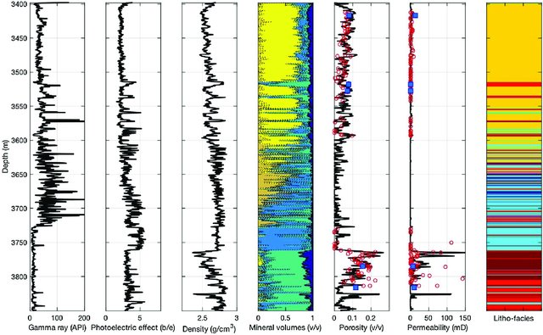
Introduction
Reliable rock classification is vital when target zones for successful hydraulic fracturing treatment are being identified and should incorporate the following properties (Aderibigbe et al., 2016)
Petrophysical (e.g., porosity, permeability, and water saturation)
Compositional (e.g., volume of kerogen, quartz, calcite, and clay)
Geological (e.g., rock facies)
Geomechanical (e.g., minimum horizontal stress)
Figure 4. Rock classification inputs example (Grana et al., 2017)

Slide 6
Introduction
Rock classification based on the core observation and laboratory tests
Costly
Estimations for discrete samples, not for whole depth interval
Time-consuming
Well log-based classification
Time and Cost are eliminated
Estimations for whole depth interval

Slide 7
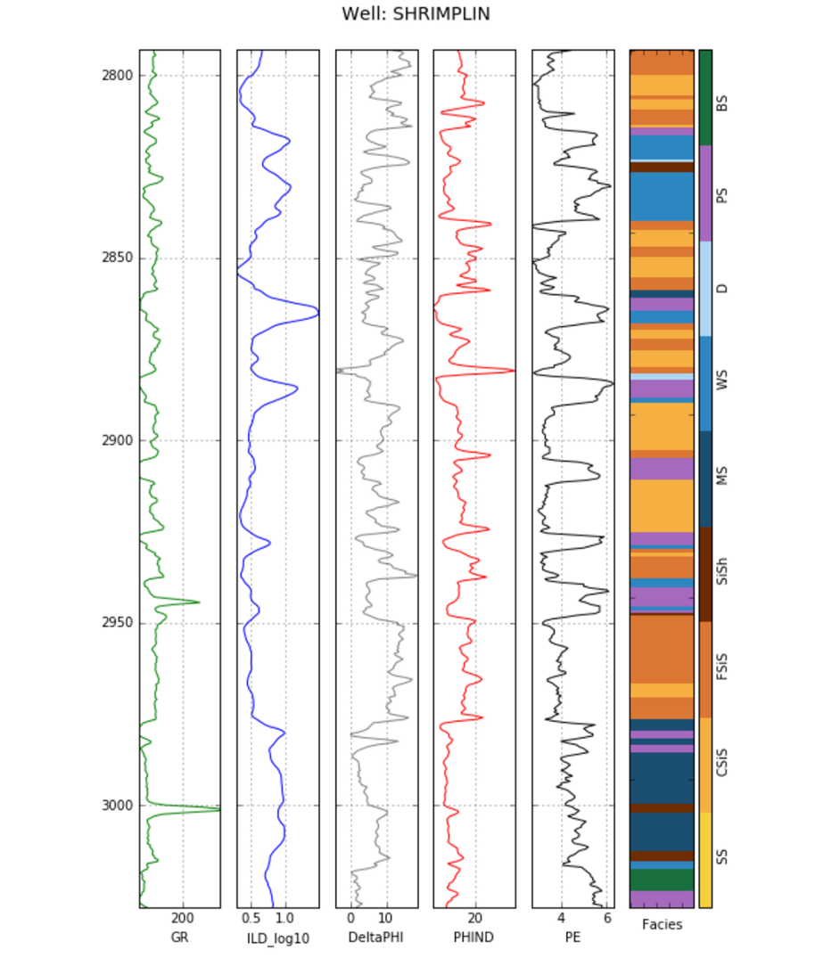
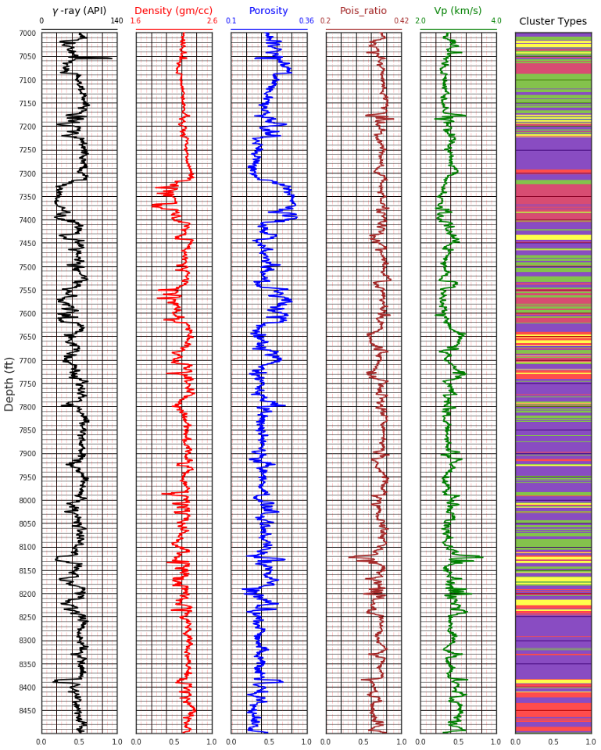
Introduction
Application of Machine Learning (ML) for well log-based classification
Supervised learning (Output available)
Unsupervised learning (No output)
Figure 5. Rock classification tasks (https://towardsdatascience.com/)

Slide 8
Materials and Methods
Rock class classification
Input well logs
Well log | Feature name
True Vertical Depth | DEPT
Gamma Ray | GR
Resistivity | AT90
Density | DPHZ
Neutron Porosity | NPHI
Supervised ML techniques
Target
Rock class*
*-From heterogeneous rock analysis (HRA), a workflow that identifies rock classes defined in a reference well (e.g., wells with core) and compares them with a subsequent well.

Slide 9
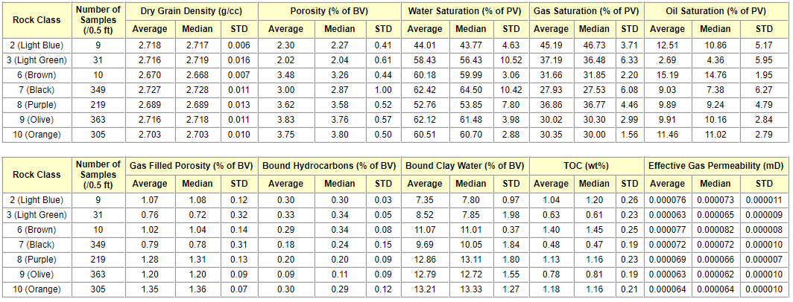
Materials and Methods
7 out of 10 rock classes for the Tuscaloosa interval are present in TMS
Rock class
1 (Blue)
2 (Light blue)
3 (Light green)
4 (Yellow)
5 (Red)
6 (Brown)
7 (Black)
8 (Purple)
9 (Olive)
10 (Orange)
Petrophysical properties of rock classes in TMS:

Slide 10
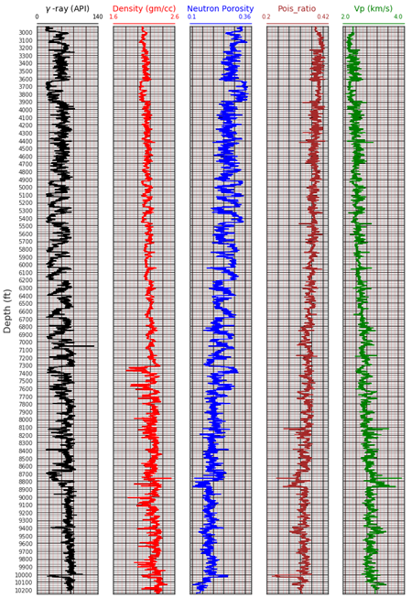

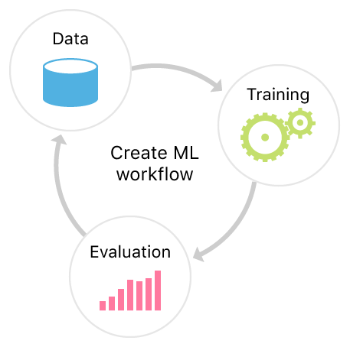
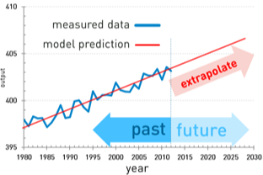
Materials and Methods
Supervised ML framework
Raw data
Input well logs (features)
Rock classes (target)
Data preprocessing
Cleaning
Outlier removal
Scaling
Train/test split
Model training
Evaluate several models
Identify the one with best performance
Model prediction
Predict rock classes
Compare to the actual data

Slide 11
Materials and Methods
Reservoir Quality clustering
Well-log based estimate
Effective porosity
Water saturation
Clay content
Quartz content
Calcite content
Kerogen content
Oil volume
Water volume
Unsupervised ML techniques
Target
Reservoir Quality clusters
Unsupervised ML techniques
Stress Magnitude clustering
Well-log based estimate
Anisotropic minimum horizontal stress
Target
Stress Magnitude clusters

Slide 12
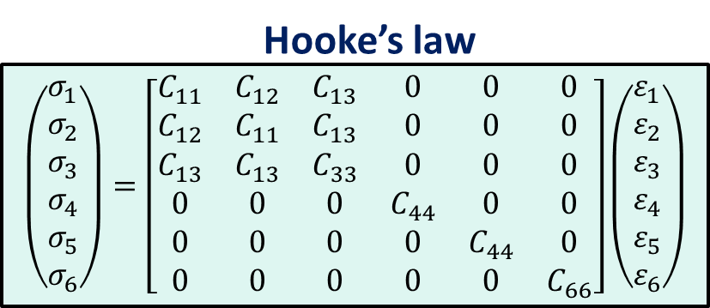
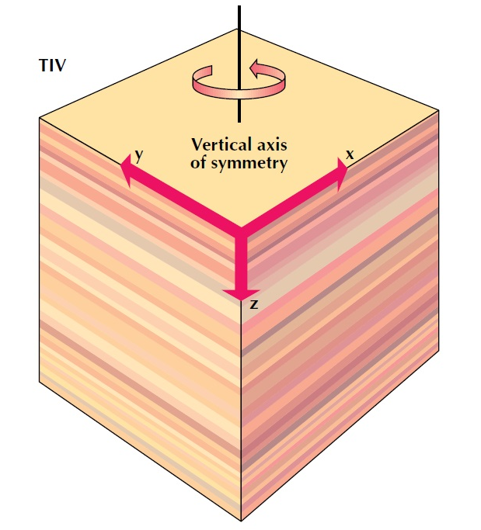
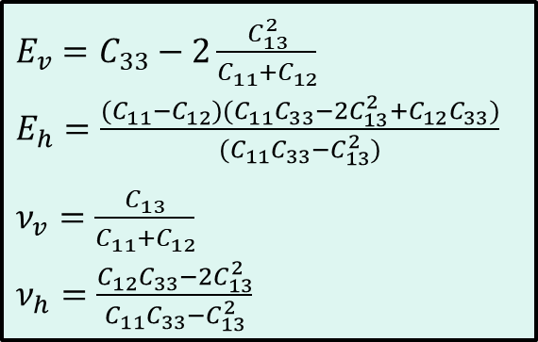
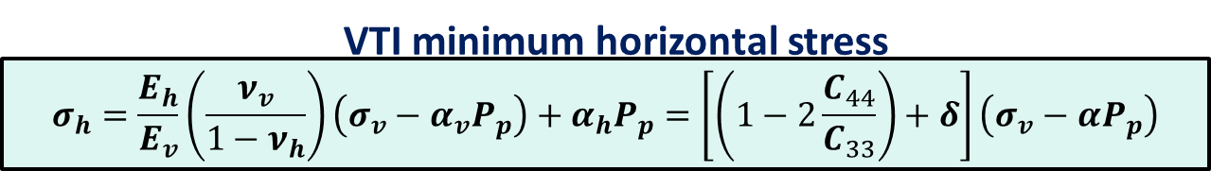
Materials and Methods
(schlumberger.com)

Slide 13
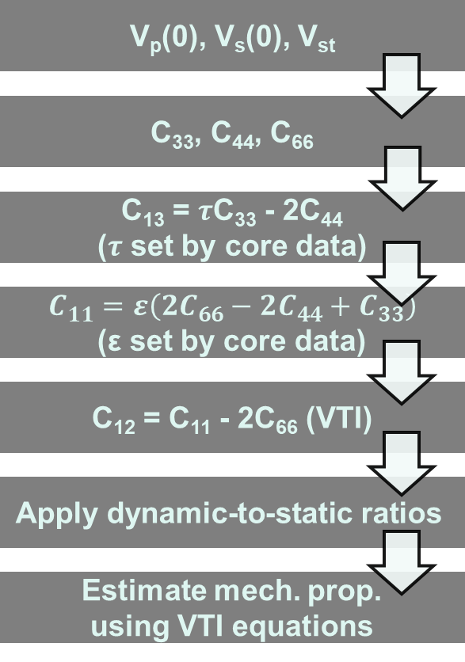
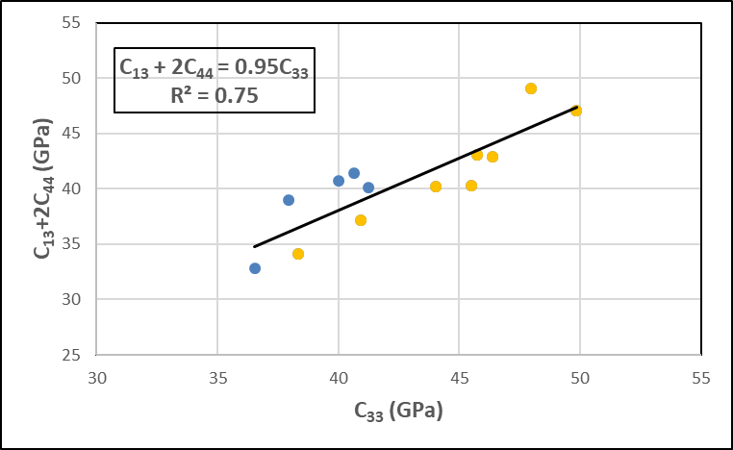
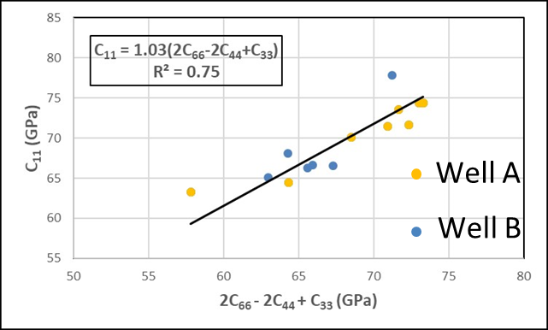
Materials and Methods
Analytical model for anisotropic minimum horizontal stress estimation
An empirical 1D geomechanical model was developed
The proposed method was used to estimate the mechanical properties analytically
Model employs correlations from ultrasonic data to predict C₁₃ and C₁₁
(Ruse and Mokhtari, 2020)

Slide 14
Materials and Methods
Unsupervised ML framework
Raw data
Input well logs (features)
Data preprocessing
Cleaning
Outlier removal
Scaling
Model prediction
Divide into the clusters based on similarity measure

Slide 15
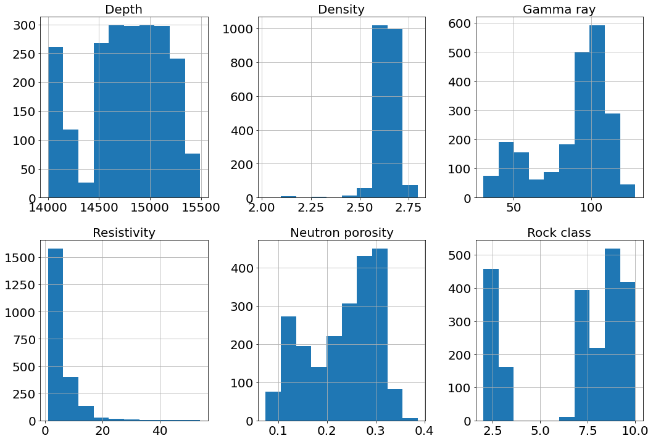
Results: Rock class classification
Data Preprocessing
Outliers were removed for the Density log.
Stratified sampling was used for train/test split.
Input features were scaled to the range (0,1).
2175 data points.

Slide 16
Results: Rock class classification
75 % of data used to train ML models, 25 % left out for prediction.
ML model | Accuracy for training set | Accuracy for validation set*
Linear SVM | 0.87 | 0.85
Polynomial SVM | 0.89 | 0.87
SVM with RBF kernel | 0.86 | 0.85
Random Forest | 0.92 | 0.88
Gradient Boosting | 0.97 | 0.87
*-If the accuracy is closer to the training accuracy, the model performed well on the data that it has not been trained on.

Slide 17
Results: Rock class classification
The models were fine-tuned using the Grid Search method with a specific set of parameters for each model.
ML model | Best parameters | Accuracy for training set | Accuracy for validation set
Support Vector Machine | kernel=rbf, C=1000, gamma=1 | 0.91 | 0.88
Random Forest | depth=6, trees=70 | 0.92 | 0.88
Gradient Boosting | base estimator=Decision tree, depth=2, trees=150, learning rate=0.1 | 0.99 | 0.89

Slide 18
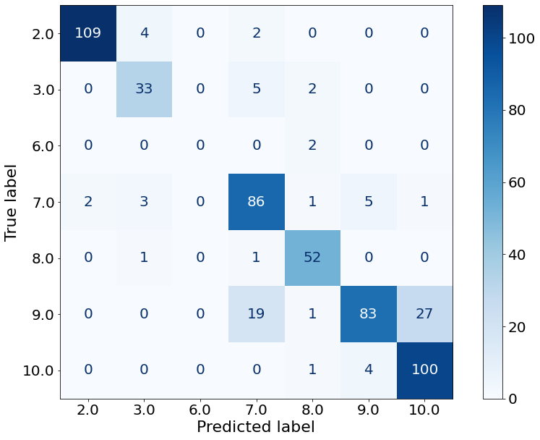
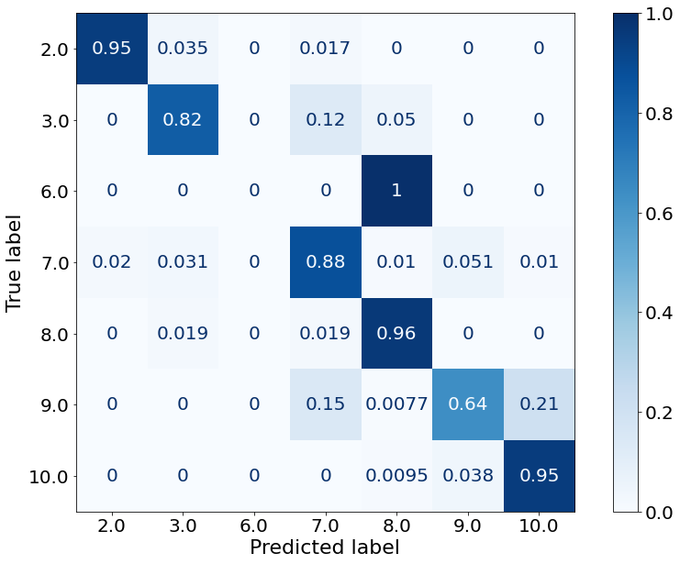
Results: Rock facies classification
Rock classes were predicted for the left out data using Random Forest model.
Accuracy for test set: 0.85

Slide 19
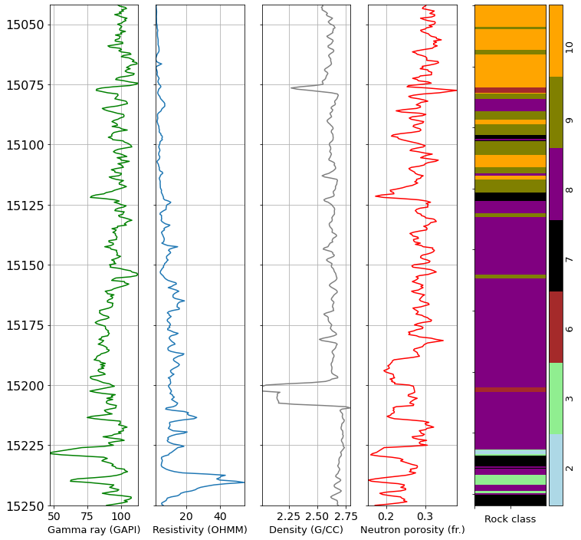
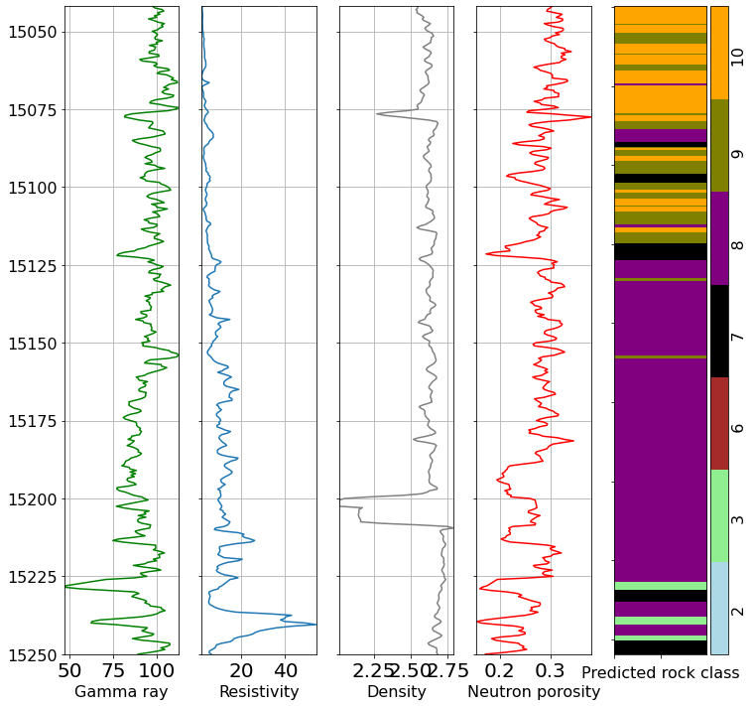
Results: Rock facies classification
Predicted rock classes in TMS interval

Slide 20
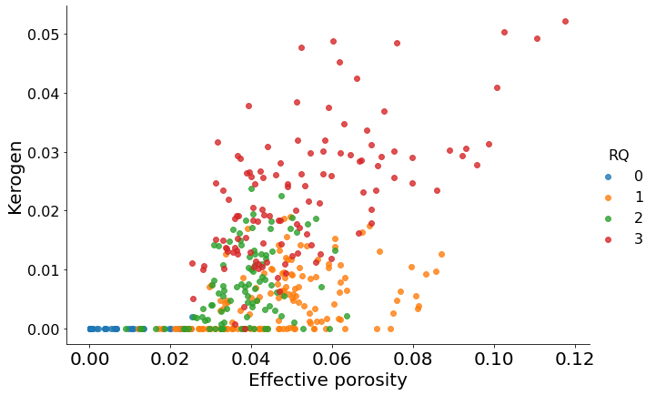
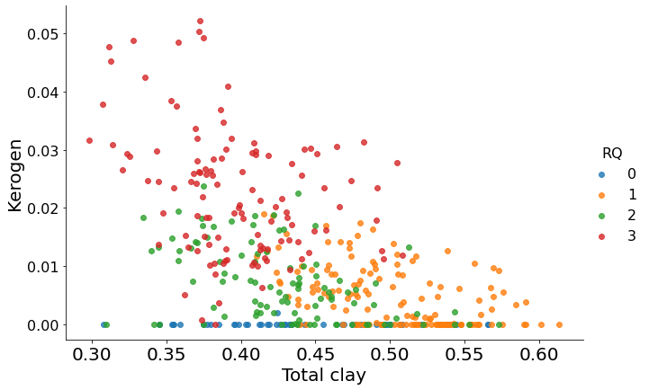
Results: Reservoir Quality clusters
K-means algorithm divided data into the 4 RQ clusters.
RQ=0:
Low porosity
Low kerogen content
High clay
RQ=3:
High porosity
High kerogen
Low clay
Better Reservoir Quality

Slide 21
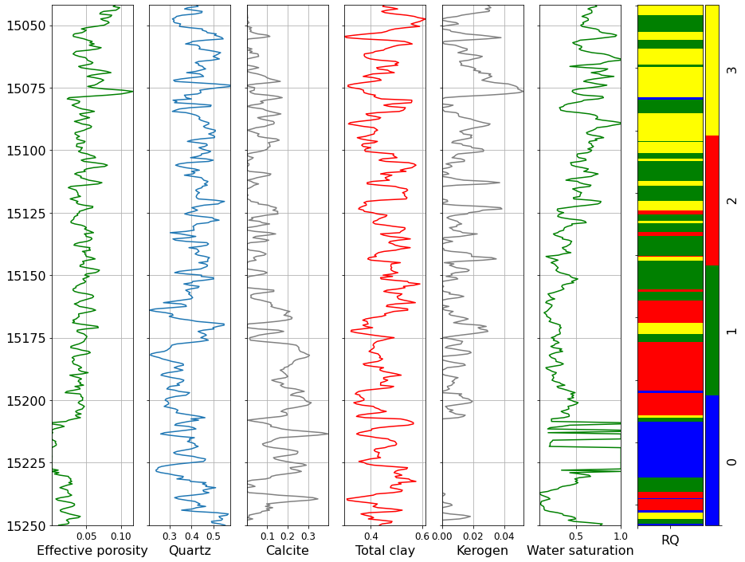
Results: Reservoir Quality clusters
All properties are expressed in volume fraction (ft3/ft3).

Slide 22
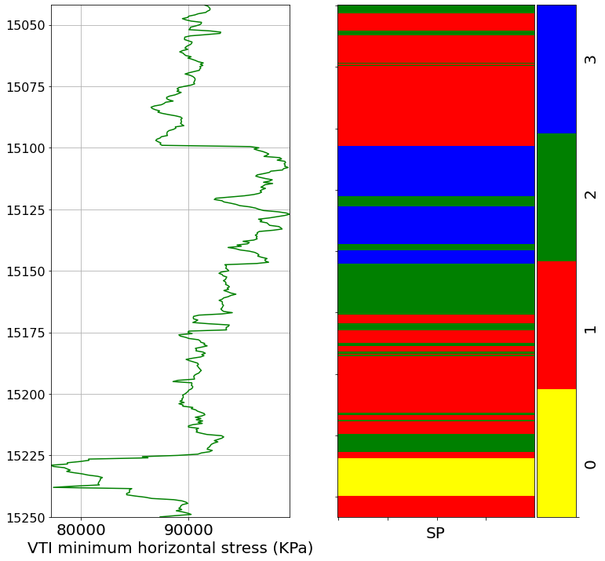
Results: Stress Profile clusters
K-means algorithm divided data into the 4 SP clusters.
SP=0:
Fracture initiation zone
Higher minimum horizontal stress
SP=3:
Fracture containment zone

Slide 23
Results: Fracturing Candidate Selection
Potential fracturing intervals based on reservoir quality, stress profile and rock classes.

Slide 24
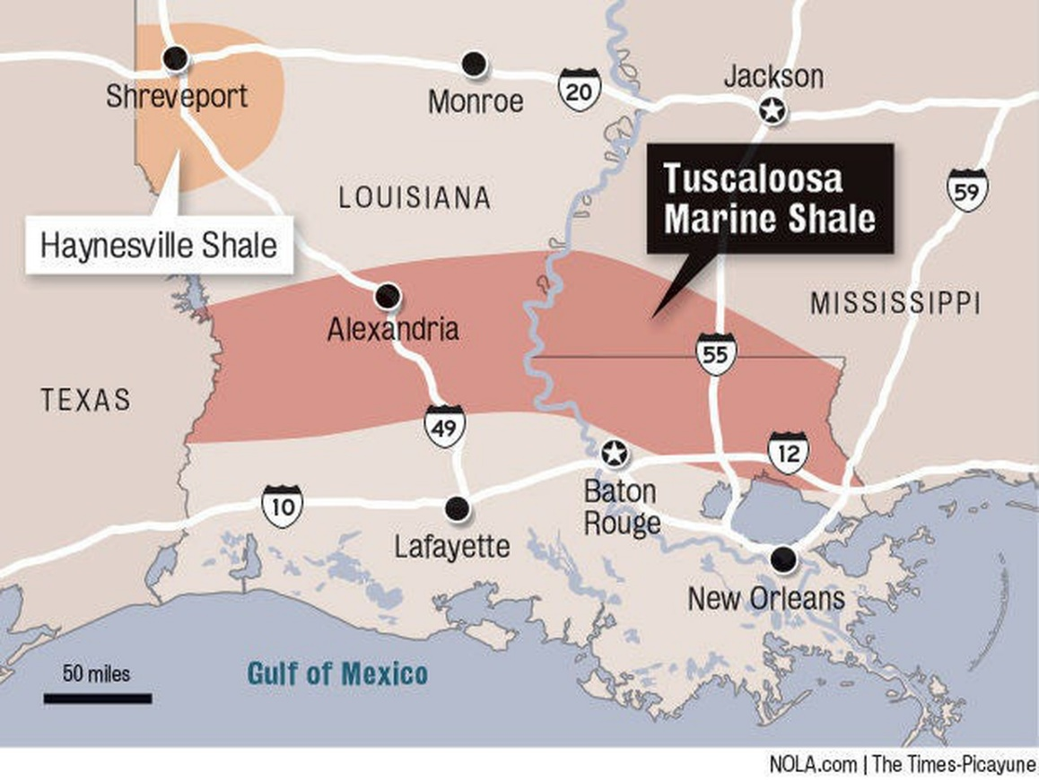




Conclusions
The integrated ML framework based on petrophysical, compositional and geomechanical properties was developed to screen fracturing candidates.
The intervals with high RQ and low stress gradients in the upper and lower part of TMS were selected as potential fracturing candidates.
The results can provide valuable insights into the optimization of completion in TMS and ultimately, enable economic recovery.
Figure 6. Big picture: Impact of results at economic level

Slide 25



Acknowledgements
Thanks to
U.S. Department of Energy and industry partners for the project grant.
Our advisor, Dr. Mehdi Mokhtari, who always gave valuable suggestions.
Our colleagues in TMSL team, who shared their valuable opinions.

Slide 26
References
Aderibigbe, Aderonke, Clotilde Chen Valdes, and Zoya Heidari. "Integrated rock classification in the Wolfcamp Shale based on reservoir quality and anisotropic stress profile estimated from well logs." Interpretation 4, no. 2 (2016): SF1-SF18.
Hackley, Paul C., Catherine B. Enomoto, Brett J. Valentine, William A. Rouse, Celeste D. Lohr, Frank T. Dulong, Javin J. Hatcherian et al. Assessment of undiscovered continuous oil and gas resources in the Upper Cretaceous Tuscaloosa marine shale of the US Gulf Coast, 2018. No. 2018-3043. US Geological Survey, 2018.
Ruse, Cristina Mariana, and Mehdi Mokhtari. "Characterization of elastic mechanical properties of Tuscaloosa Marine Shale from well logs using the vertical transversely isotropic model." Interpretation 8, no. 4 (2020): T1023-T1036.
Grana, Dario, Sumit Verma, Josiane Pafeng, Xiaozheng Lang, Hema Sharma, Wenting Wu, Fred McLaughlin et al. "A rock physics and seismic reservoir characterization study of the Rock Springs Uplift, a carbon dioxide sequestration site in Southwestern Wyoming." International Journal of Greenhouse Gas Control 63 (2017): 296-309.
https://www.netl.doe.gov/sites/default/files/netl-file/M-Mokhtari-Tuscaloosa-Marine-Shale.pdf

Slide 27

Thank you for your attention!
Any questions?

Slide 28
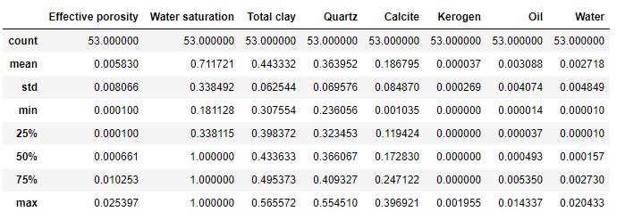
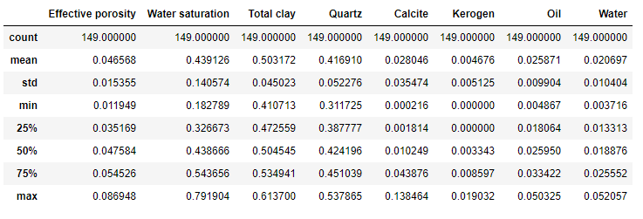
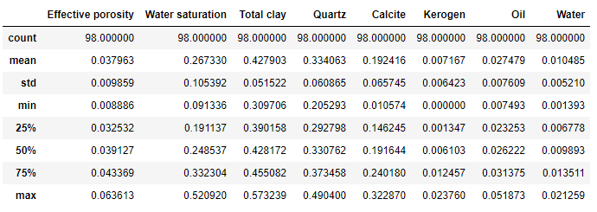
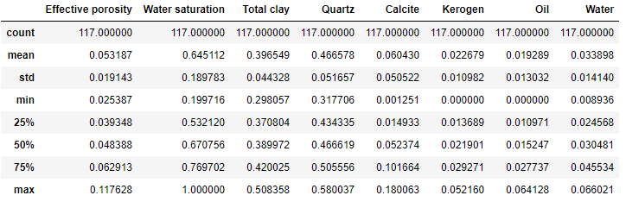
Appendix
RQ 0
RQ 1
RQ 2
RQ 3

